Slide 1

System Design
Based on Chapter 13 of Bennett, McRobb and Farmer:
Object Oriented Systems Analysis and Design Using UML, (2nd Edition), McGraw Hill, 2002.

Slide 2
In This Lecture You Will Learn:
The major concerns of system design
The main aspects of system architecture, in particular what is meant by subdividing a system into layers and partitions
How to apply the MVC architecture
Which architectures are most suitable for distributed systems
How design standards are specified

Slide 3
System Architecture
A major part of system design is defining the system architecture
  Containing potentially human, software and hardware elements and how these elements are structured and interact
The software elements of the system embody the software architecture
Notes:
The architecture of the information system is first considered early in the project during the requirements capture and analysis activities. This first view of the system architecture is driven significantly by the use cases and then informs the continuing requirements capture and analysis activities. This forms a useful basis from which to develop the design architecture. The detailed software architecture of a computerized information system develops as the design process continues into class design but it is important to identify an overall system architecture within which the detail can be refined. High-level architectural decisions that are made during system design determine how successfully the system will meet its non-functional objectives (e.g. performance, extensibility) and thus its long-term utility for the client. Reuse is one of the much-vaunted benefits of object-orientation and poor software architecture usually reduces both the reusability of the components produced and the opportunity to reuse existing components.

Slide 4
System Design
During system design the following activities are undertaken:
  Sub-systems and major components are identified
  Any inherent concurrency is identified
  Sub-systems are allocated to processors
  A data management strategy is selected
  A strategy and standards for human–computer interaction are chosen

Slide 5
System Design
Activities during system design:
  Code development standards are specified
  The control aspects of the application are planned
  Test plans are produced
  Priorities are set for design trade-offs
  Implementation requirements are identified (for example, data conversion)

Slide 6
Software Architecture
‘A software architecture is a description of the subsystems and components of a software system and the relationships between them. Sub-systems and components are typically specified in different views to show the relevant functional and non-functional properties of a software system. The software architecture of a system is an artefact. It is the result of the software design activity.’
Buschmann et al. (1996)

Slide 7
Sub-systems
A sub-system typically groups together elements of the system that share some common properties
An object-oriented sub-system encapsulates a coherent set of responsibilities in order to ensure that it has integrity and can be maintained
Notes:
For example, the elements of one sub-system might all deal with the human–computer interface, the elements of another might all deal with data management and the elements of a third may all focus on a particular functional requirement.

Slide 8
Sub-systems
The sub-division of an information system into sub-systems has the following advantages
  It produces smaller units of development
  It helps to maximize reuse at the component level
  It helps the developers to cope with complexity
  It improves maintainability
  It aids portability

Slide 9
Sub-systems
Each sub-system provides services for other sub-systems, and there are two different styles of communication that make this possible
These are known as client–server and peer-to-peer communication

Slide 10
Styles of communication between sub-systems
«client»
Sub-system A
«peer»
Sub-system C
«server»
Sub-system B
«peer»
Sub-system D
The server sub-system does
not depend on the client sub-system and is not affected by changes to the client’s interface.
Each peer sub-system depends on the other and each is affected by changes in the other’s interface.

Slide 11
Client–server communication
Client–server communication requires the client to know the interface of the server sub-system, but the communication is only in one direction
The client sub-system requests services from the server sub-system and not vice versa

Slide 12
Peer-to-peer communication
Peer-to-peer communication requires each sub-system to know the interface of the other, thus coupling them more tightly
The communication is two way since either peer sub-system may request services from the other

Slide 13
Layering and Partitioning
Two general approaches to the division of a software system into sub-systems
  Layering—so called because the different sub-systems usually represent different levels of abstraction
  Partitioning, which usually means that each sub-system focuses on a different aspect of the functionality of the system as a whole
Both approaches are often used together on one system

Slide 14
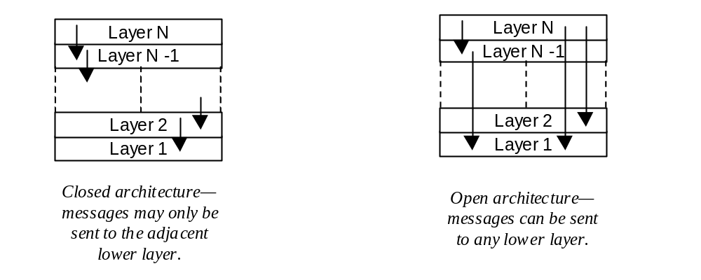
Schematic of a
Layered Architecture

Slide 15
Layered Architecture
A closed architecture minimizes dependencies between the layers and reduces the impact of a change to the interface of any one layer
An open layered architecture produces more compact code, the services of all lower level layers can be accessed directly by any layer above them without the need for extra program code to pass messages through each intervening layer, but this breaks the encapsulation of the layers

Slide 16
OSI
7 Layer
Model
Layer 7: Application
Provides miscellaneous protocols for common activities.
Layer 6: Presentation
Structures information and attaches semantics.
(Adapted from Buschmann et al., 1996)
Layer 5: Session
Provides dialogue control and synchronization facilities.
Layer 4: Transport
Breaks messages into packets and ensures delivery.
Layer 3: Network
Selects a route from sender to receiver.
Layer 2: Data Link
Detects and corrects errors in bit sequences.
Layer 1: Physical
Transmits bits: sets transmission rate (baud), bit-code, connection, etc.

Slide 17
Applying a Layered Architecture
Issues that need to be addressed include:
  maintaining the stability of the interfaces of each layer
  the construction of other systems using some of the lower layers
  variations in the appropriate level of granularity for sub-systems
  the further sub-division of complex layers
  performance reductions due to a closed layered architecture
(Buschmann et al., 1996)
Notes:
suggest that a series of issues need to be addressed when applying a layered architecture in an application. These include:
·

Slide 18

Simple Layered Architecture.

Slide 19
Developing a Layered Architecture
Define the criteria by which the application will be grouped into layers. A commonly used criterion is level of abstraction from the hardware.
Determine the number of layers.
Name the layers and assign functionality to them.
Specify the services for each layer.
Refine the layering by iterating through steps 1 to 4.

Slide 20
Developing a Layered Architecture
Specify interfaces for each layer.
Specify the structure of each layer. This may involve partitioning within the layer.
Specify the communication between adjacent layers (this assumes that a closed layer architecture is intended).
Reduce the coupling between adjacent layers. This effectively means that each layer should be strongly encapsulated.
(Adapted from Buschmann et al., 1996)

Slide 21
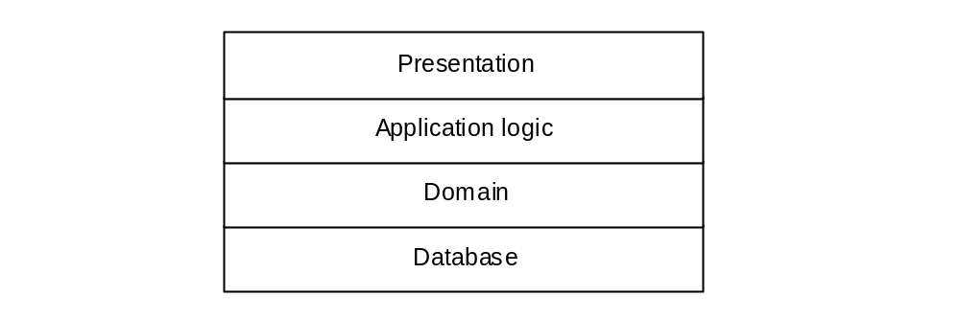
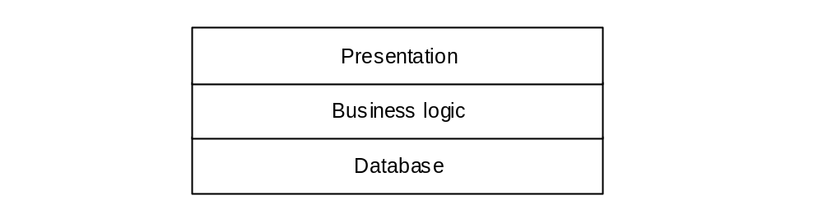
Three & Four Layer Architectures.
Business logic layer
can be split into two layers

Slide 22
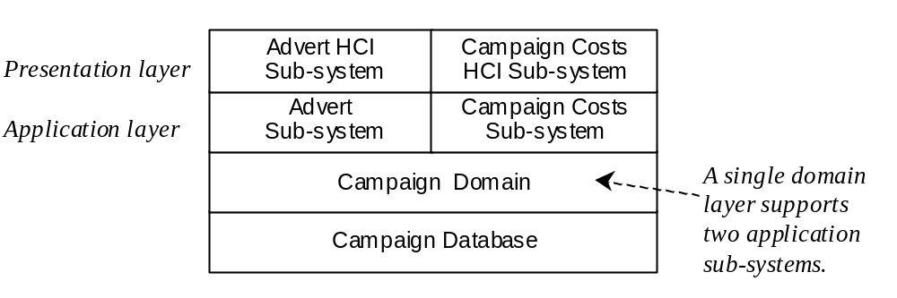
Partitioned Sub-systems
Loosely coupled sub-systems, each delivering a single service or coherent group of services
Four layer architecture applied to part of the Agate campaign management system

Slide 23
Problems with some Architectures
Each sub-system contains some core functionality
Changes to data in one sub-system need to be propogated to the others
Campaign
Forecasting
Advert
Development
Campaign
Management
Campaign and Advert Database Access
Multiple interfaces for the same core functionality.

Slide 24
Difficulties
We repeat below some of the difficulties that need to be resolved for this type of application
  The same information should be capable of presentation in different formats in different windows
  Changes made within one view should be reflected immediately in the other views
  Changes in the user interface should be easy to make
  Core functionality should be independent of the interface to enable multiple interface styles to co-exist

Slide 25
Model-View-Controller
The propagation mechanism
View A
«propagate»
«propagate»
View B
«access»
«access»
«access»
«access»
Model
«access»
«access»
Controller A
Controller B
(Adapted from Hopkins and Horan, 1995)

Slide 26
Model-View-Controller
Model—provides the central functionality of the application and is aware of each of its dependent view and controller components.
View—corresponds to a particular style and format of presentation of information to the user. The view retrieves data from the model and updates its presentations when data has been changed in one of the other views. The view creates its associated controller.

Slide 27
Model-View-Controller
Controller—accepts user input in the form of events that trigger the execution of operations within the model. These may cause changes to the information and in turn trigger updates in all the views ensuring that they are all up to date.
Propagation Mechanism—enables the model to inform each view that the model data has changed and as a result the view must update itself. It is also often called the dependency mechanism.

Slide 28
MVC applied to Agate
«component»
AdvertView
depends on
*
viewData
Navigability arrows show the
initialize()
1
directions in which messages
displayAdvert()
will be sent.
update()
«component»
.
CampaignModel
coreData
1
setOfObservers [0..*]
attach(Observer)
updates
detach(Observer)
1
notify()
«component»
getAdvertData()
modifyAdvert()
AdvertController
1
updates
*
initialize()
changeAdvert()
update()
Notes:
The operation update() in the AdvertView and AdvertController components triggers these components to request data from the CampaignModel component[1]. This model component has no knowledge of the way that each view and controller component will use its services. It need only know that all view and controller components must be informed whenever there is a change of state (a modification either of object attributes or of their links).
The attach() and detach() services in the CampaignModel component enable views and controllers to be added to the setOfObservers. This contains a list of all components that must be informed of any change to the model core data. In practice there would be separate views, each with its own controller, to support the requirements of the campaign manager and the director.
[1] In this example the CampaignModel will hold details of campaigns and their adverts.

Slide 29
MVC Component Interaction
:AdvertController
:CampaignModel
:AdvertView
changeAdvert()
modifyAdvert()
notify()
update()
displayAdvert()
getAdvertData()
update()
getAdvertData()

Slide 30
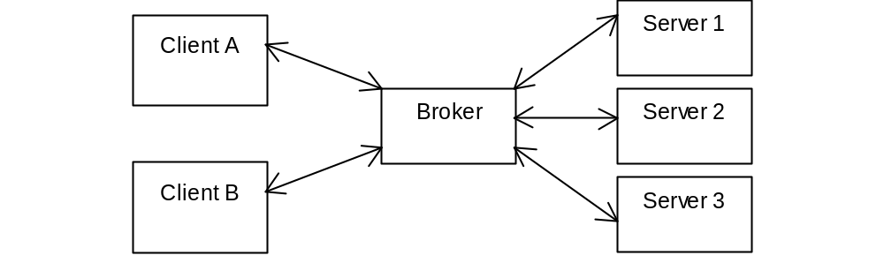
Schematic of Simplified Broker Architecture

Slide 31
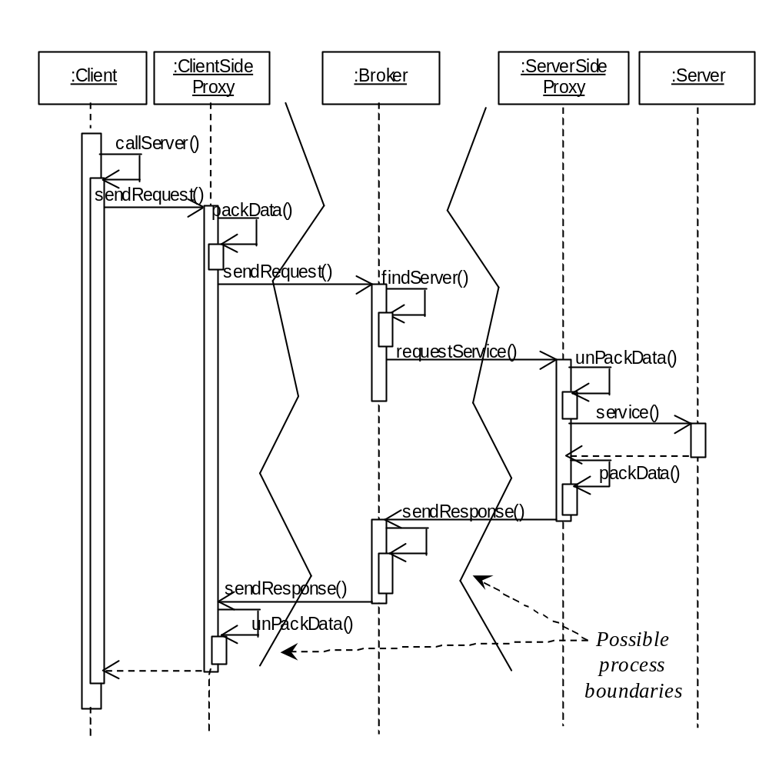
(Adapted from Buschmann et al., 1996)
Notes:
Broker architecture for local server (adapted from Buschmann et al., 1996).

Slide 32
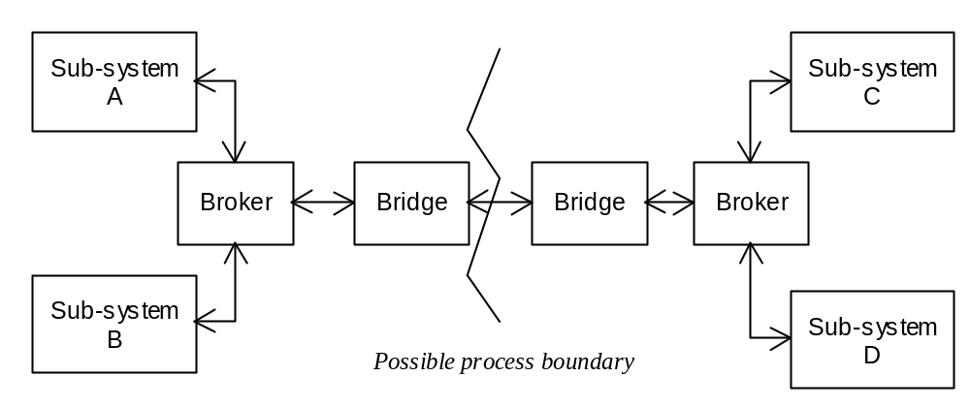
Schematic of broker architecture using bridge components

Slide 33
Concurrent activity in an interaction diagram
:ClassA
:ClassB
:ClassC
:ClassD
Asynchronous messages
Simultaneous
execution
Do not execute
simultaneously

Slide 34
Scheduler Handling Concurrency
This thread of execution generates a system output.
Sub-system 2
Sub-system 1
Thread of control invoked by scheduler and produces no output.
«invoke»
«invokes»
«interrupt»
Scheduler
«interrupt»
I/O Sub-system A
Interrupts generated in scheduler.
I/O Sub-system B

Slide 35
Processor Allocation
Allocation of a system to multiple processors
  Application should be divided into sub-systems
  Estimate processing requirements for sub-systems
  Determine access criteria and location requirements
  Identify concurrency requirements
  Each sub-system should be allocated to an operating platform
  Communication requirements between sub-systems should be determined
  The communications infrastructure should be specified

Slide 36
Data Management Issues
DBMS provide
  Different views of the data by different users
  Control of multi-user access
  Distribution of the data over different platforms
  Security
  Enforcement of integrity constraints
  Access to data by various applications
  Data recovery
  Portability across platforms
  Data access via query languages
  Query optimization

Slide 37
Development Standards
HCI guidelines
Input/output device guidelines
Construction guidelines

Slide 38
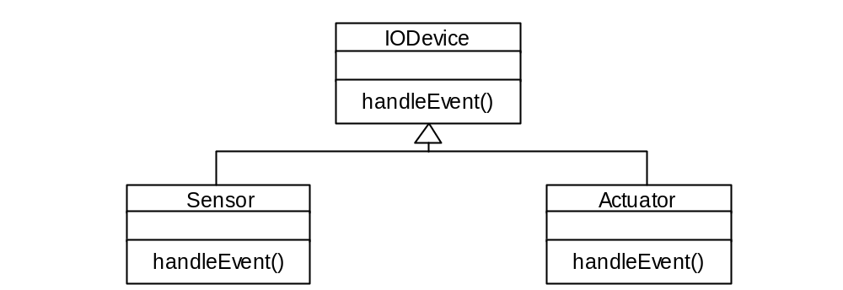
I/O Device Hierarchy
I/O Hierarchy providing consistency for device handling

Slide 39
Prioritizing Design Trade-offs
Designer is often faced with design objectives that are mutually incompatible
It is helpful if guidelines are prepared for prioritizing design objectives
If design choice is unclear users should be consulted

Slide 40
Design for Implementation
Initialization and implementation issues should be considered
There may be data transfer or data conversion requirements or both

Slide 41
Summary
In this lecture you have learned about:
  The major concerns of system design
  The main aspects of system architecture, in particular what is meant by subdividing a system into layers and partitions
  How to apply the MVC architecture
  Which architectures are most suitable for distributed systems
  How design standards are specified

Slide 42
References
Buschmann et al. (1996).
Jacobson et al. (1997)
(For full bibliographic details, see Bennett, McRobb and Farmer)

